Slide 1
Donation Tracking System

Slide 2
ABSTRACT
The primary issue in the majority of the world's nations is poverty and hunger. Many non-governmental organisations (NGOs) are aiming to reduce hunger and poverty in society. These groups collect money for this purpose and organise fund-raising activities so that anyone can contribute. The majority of NGOs have had trouble obtaining cash or other necessary items. Obtaining donors is a highly difficult endeavour, and occasionally dealing with some donors' conditions can be quite difficult for NGOs to complete.

Slide 3
We suggested the Donation Tracking System as a solution to the issues currently present. NGOs may easily manage the tracking of donations with the use of this contribution tracking system. With the help of this project, such groups will be able to handle their donations and resources more effectively. A type of nonprofit software called a donation tracking system helps organisations better understand and make the most of their contributor connections. As a tool for managing donor relationships, the application organises donor data, identifies donor patterns, and provides recommendations to increase the likelihood of receiving future gifts.

Slide 4
The creation of a system to track donations is the goal of this project. The donors can trace their donations with the aid of this method. Additionally, this approach aids in the appeal for donations from the charity. The administrator will oversee the donors and charity in the meanwhile. The suggested project serves as a full donation management system and tracking mechanism.

Slide 5
EXISTING SYSTEM
Everything in the existing system is done manually on paper. This decreases efficiency and increases the likelihood of errors, so a "computerised system" is required to duplicate the current environment since it will boost efficiency, cut down on errors to a minimum, and be cost-effective.

Slide 6
The existing system relies solely on human data handling. It involves keeping a donor registration. It entails keeping a registry of records. The donors receive handwritten invoices. Receipt books are used to record money received. The individuals may or may not be available when needed.

Slide 7
DISADVANTAGES OF EXISTING SYSTEM
The primary issue with the existing system is its lack of openness.
As a result of the donors losing faith in these organisations as a result of the manual system maintenance or their own format of computerised system, relations with charitable organisations terminate. This makes it more difficult for NGOs to raise money in an efficient manner.

Slide 8
There are numerous groups today that solicit donations in order to provide social services. However, due to adhering to the established method, the majority of them decline to demonstrate the advancement they have made with the money supplied by the donors. This leads many donors to believe that all donation services are fake or scams, which discourages them from giving money to any charity.
Lack of accountability.
Conventional systems leave a huge gap in interactions among donors and charity/NGO.

Slide 9
PROPOSED SYSTEM
In the suggested system, we create a Java-based system for collecting donations over the Internet or World Wide Web. If desired, a donor may be a person or a person acting on behalf of an organisation having a specific interest in a charity organisation. The charitable organisation is a non-profit group with a website or online presence. A donation is chosen by the donor in consultation with the nonprofit. The system is now in touch with the donor and the nonprofit organisation in a way that is transparent to the giver.

Slide 10
In order to address the primary problems faced by charity management companies, this project will first make it possible for people to donate online rather than by phone, which is advantageous for both donors and NGOs. Additionally, donors can learn on the web about the history of the NGOs, the range of services they provide, and the Helps they have provided. Second, by just being published online, the project will be a simpler approach to promote the Company.

Slide 11
By the completion of this project, it is hoped that the charity organisation using this web-based strategy will be able to maintain track of donation records, reduce the volume of incoming phone calls, and finally assist in reaching the target number of donors.

Slide 12
Once more, the project's goal is to persuade the Charity Management system to engage with donors and promote their organisation primarily through technology. Finally, the globe as a whole will profit from the realisation of this project. Through the provision of previously unavailable materials, this research advances academic knowledge. Additionally, a brief report on the execution of each project phase will be created, and more development will be available.

Slide 13
ADVANTAGES OF PROPOSED SYSTEM
The proposed system aims to make it easier for donors to receive better information so they can give from any location without difficulty.
The suggested system does not call for donor physical presence. Therefore, it is quite simple to run fundraising campaigns online even in pandemic conditions where there is no disease transmission or loss of human life.
The proposed system has good authentication so only authorized NGO can able to collect funds

Slide 14
Receipts will be made very quickly and it will be displayed in few minutes for the donors.
User Friendly Web Interface facilitating accessing from the Globe.
Good Authentication for security purpose
Excellent level of security for the data.

Slide 15
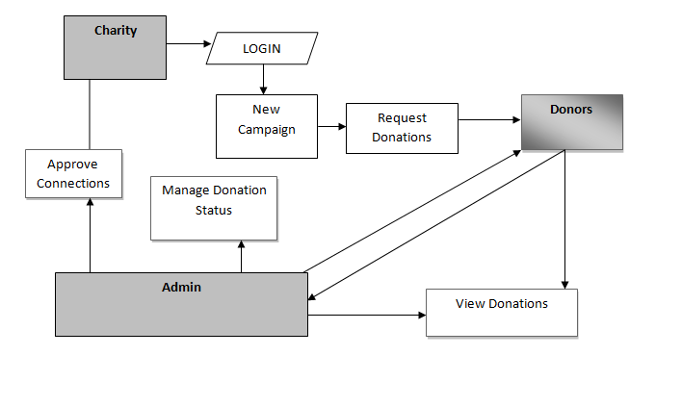
SYSTEM ARCHITECTURE

Slide 16
HARDWARE REQUIREMENTS
System : Pentium i3 Processor
Hard Disk : 500 GB.
Monitor : 15’’ LED
Input Devices : Keyboard, Mouse
Ram : 2 GB

Slide 17
SOFTWARE REQUIREMENTS
Operating system : Windows 10.
Coding Language : JAVA.
Tool : Netbeans 8.2
Database : MYSQL

